Slide 1
Predicting Credit Default Risk with Machine Learning in R
By Michael Starbuck
Regis University MSDS 692 – Data Science Practicum I

Slide 2
Introduction
There is always a threat of default when lending anything
Financial institutions lend hundreds of thousands of dollars to individual consumers to purchase homes
Need a way to know before lending the money if it will be paid back

Slide 3
Data Summary
Data was found on Kaggle’s competition site, supplied by Home Credit Group.
URL: https://www.kaggle.com/c/home-credit-default-risk/data
122 columns including the class variable, TARGET
Over 9 million NA values – 24% of all data is NA
52 categorical variables converted to factors

Slide 4
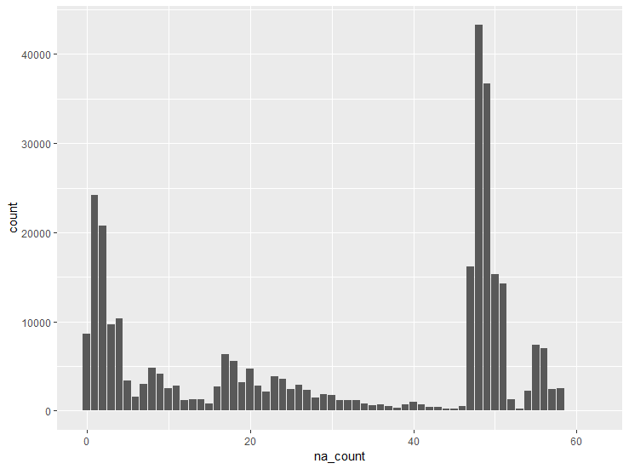
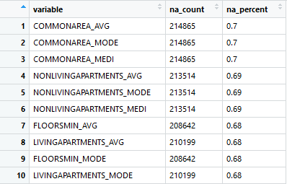
Exploring NA values
Histogram of NA counts by row
na_count column added to see NA values by row
na_table matrix created to view NA values by column
44 variables with 50% or more NA values
Top 10 values in na_table

Slide 5
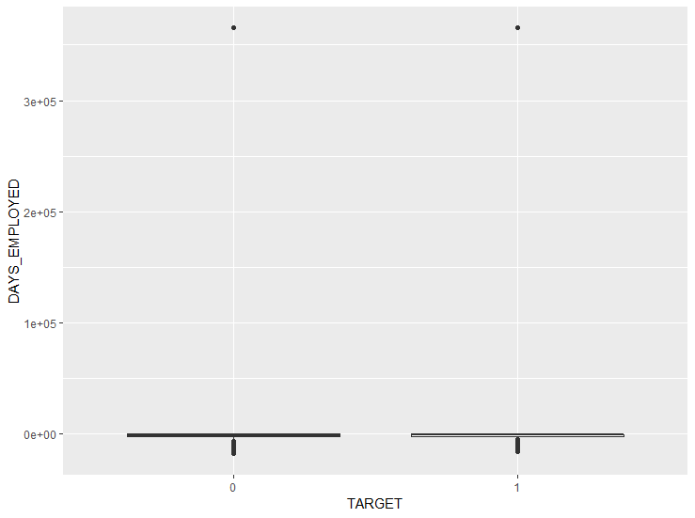
Exploring DAYS_EMPLOYED variable
The summary showed a negative mean but a positive max number
Boxplot was used to gain insight into the distribution (shown to the right)
Only one positive value which is seemingly a default, it will be changed into NA.

Slide 6
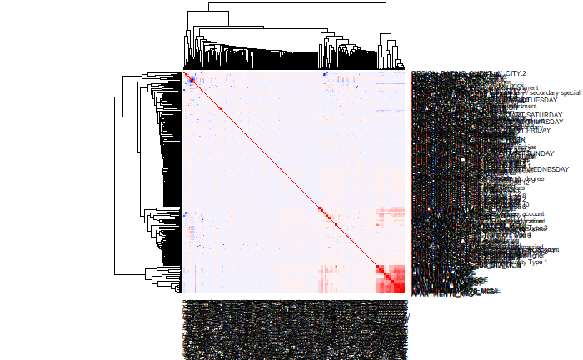
Eliminating Unnecessary Variables
Too many columns to gain any insight from a full correlation matrix plot (shown on left).
Correlation vector with target variable created and compared with na_table

Slide 7
Eliminating Unnecessary Variables (cont)
Variables with over 60% NA values not found in the top 30 most correlated were eliminated
Two variables (organization_type and hour_appr_process_start) had very low correlation and were eliminated
Still too many to impute in a reasonable time frame so NA threshold moved to 40%
65 variables (including target) remain

Slide 8
Imputing missing values
Instead of imputing factors, a new level of “None” was added
Saves time and computing power due to large amount of data
The mice package is used, three iterations over one imputation
Small number of iterations and imputations again saves time and computing power
The cart (classification and regression trees) method is used

Slide 9
Building models
Three different types of models are tested for the data
Random Forest using the randomForest package
Naïve Bayes using the e1071 package
K-nearest neighbors (KNN) using the class package
Best performing model will be optimized and selected
Balanced accuracy will be used to evaluate performance
70/30% train/test split of data utilized

Slide 10
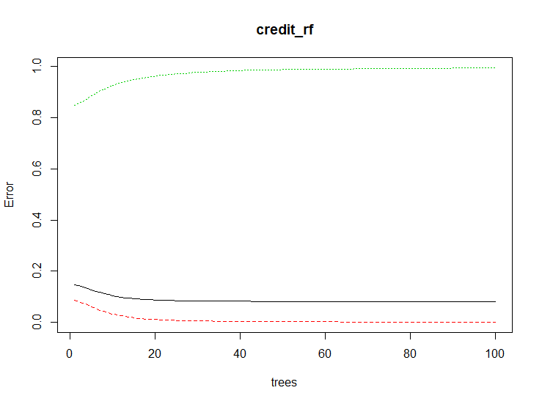
Evaluating Model Results – Random Forest
Very few records were classified as a 1 (default)
Balanced accuracy of 0.500671
Not really any better than a pure guess
The error seems to be leveling off so adding additional trees will not help

Slide 11
Evaluating Model Results – Naïve Bayes
More records classified as default
Lower pure accuracy than random forest (0.8842 vs 0.9183)
Higher balanced accuracy (0.5554 vs 0.500671)
Still not much better than a random guess

Slide 12
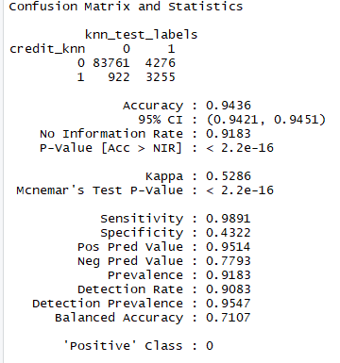
Evaluating Model Results – KNN
Best accuracy result yet at 0.9436
Best balanced accuracy yet at 0.7107
Much improved over a random guess
This is the model that will be selected to optimize

Slide 13
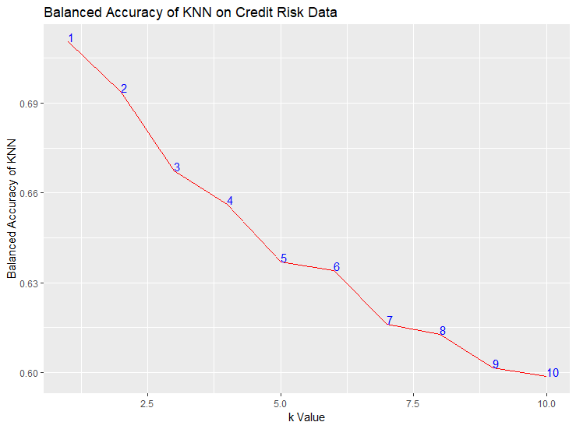
Optimizing the KNN Model
Table created to track the balanced accuracy at different k values
For loop utilized to evaluate the model at different levels of k
The ideal value for k is 1 so the original model is the selected

Slide 14
Conclusion
It is possible that more data is valuable but it is difficult to tell with so many missing values
Additional data tables available but not utilized in this project
With the data used, the accuracy is better than expected
It is possible for financial institutions to employ a model to assist in the underwriting process

Slide 15
References
Home Credit Group & Kaggle.com. (2018). Home Credit Default Risk. Raw data. Retrieved from
https://www.kaggle.com/c/home-credit-default-risk/data
Sanguansintukul, Siripun (2018) Class Materials from MSDS 680 and MSDS 660

